Slide 1
Work Flow :
Explanation about dataset
Problem statement and important parameters
Statistics
Visualizations
Time series analysis of multiple assets (close)
Time series analysis of multiple assets (returns)

Slide 2
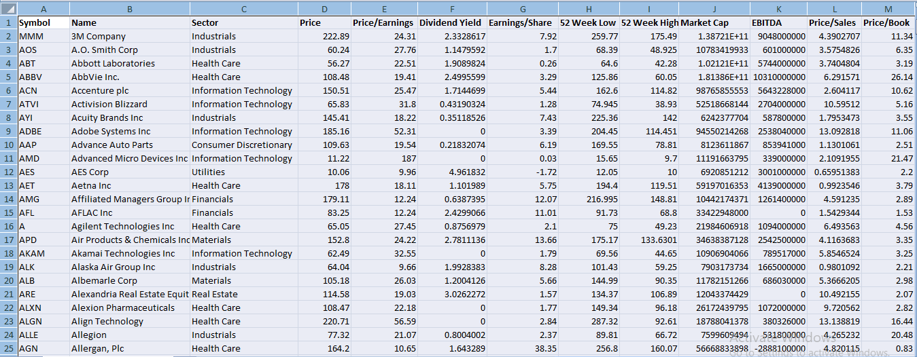
Dataset : S & P 500 Index

Slide 3

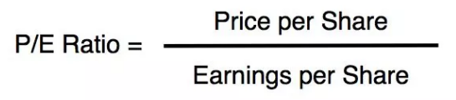
Data Explanatory :
Column 1 : Symbol
Column 2 and 3 : Name of the company and sector to which it belongs.
Column 4 : Price /share ,at which company is trading currently.
Column 5 : Price/ Earnings =
Column 6 : Dividend yield - Companies distribute a portion of their profits as dividends, it is a financial ratio that shows how much a company pay out in dividends (in percentage)each year in relation to its share price.
Column 7 : Earnings/ share - It is the portion of a company's profit allocated to each share.
Column 8 and 9 : 52 Weeks high/low – It is the highest and lowest price at which a stock has traded. It is an important factor in determining a stock's current value and predicting future price.

Slide 4

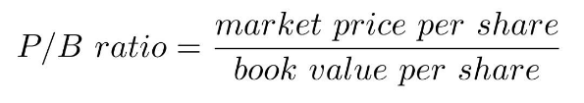
Column 10 : Market Cap – The total market value of the company. The companies whose value is smaller than (2 Billion $) are small cap companies, companies whose value between (2 Billion – 10 Billion $) are mid cap companies and companies whose value is greater than ( 10 Billion $ ) are large cap companies.
Column 11 : EBITDA - (Earnings before interest, tax, depreciation and amortization )
Column 12 : Price/sales- It takes market cap and revenue of a company to determine the stock is valued properly.
Column 13 : Price/Book-

Slide 5
Problem Statement :
If someone is investing or trading in US stock market (S&P-500 Index) for the first time , what are all the basic areas to take into consideration before making an investment.
Important Parameters :
P/E Ratio and Returns are the two important parameters by which you can decide to invest in which stock.

Slide 6
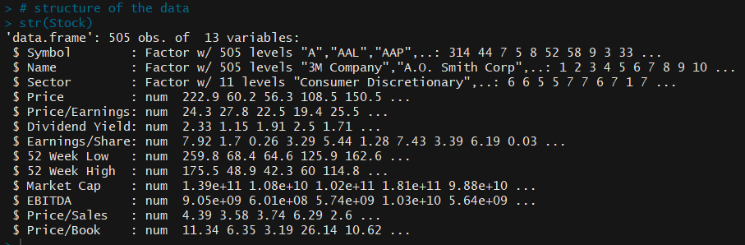
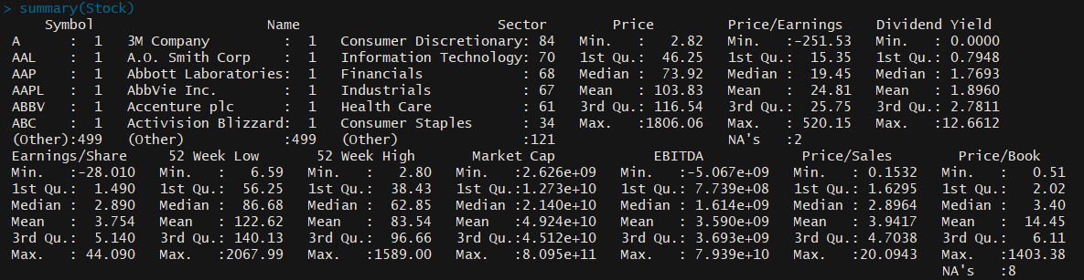
Statistics :
Structure of the data
Summary of the dataset

Slide 7
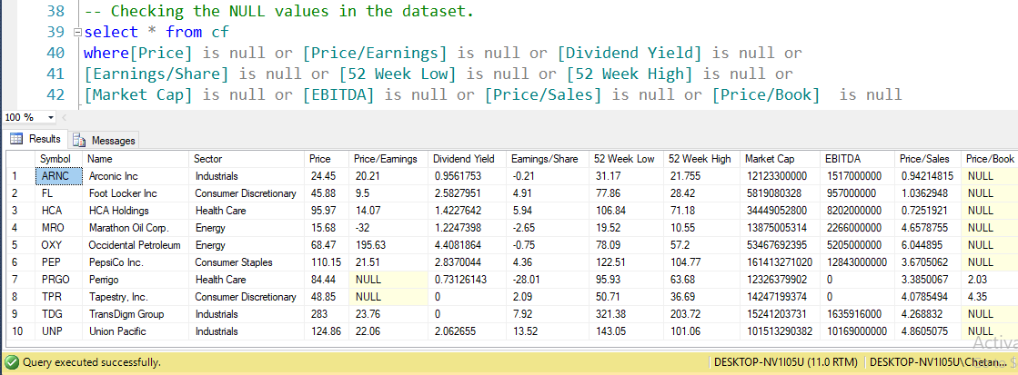
Data Cleaning :
Checking the null values in data
Removing null values
Removing all the non numeric columns from the dataset

Slide 8
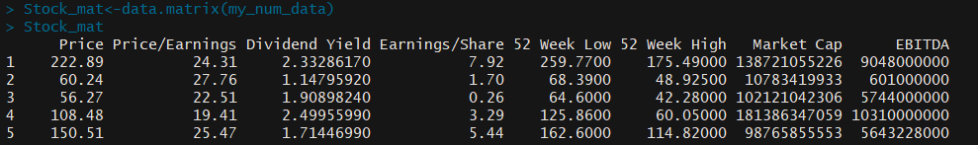
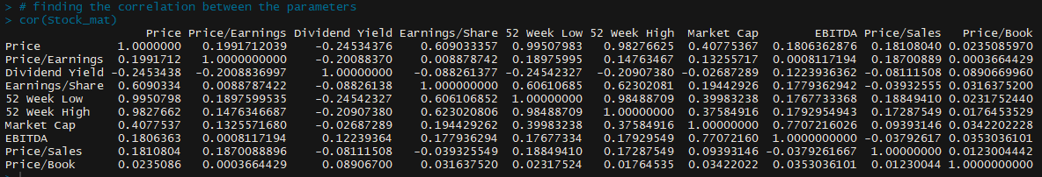
Converting the dataset into the matrix form to perform the correlation.
Performing the correlation

Slide 9
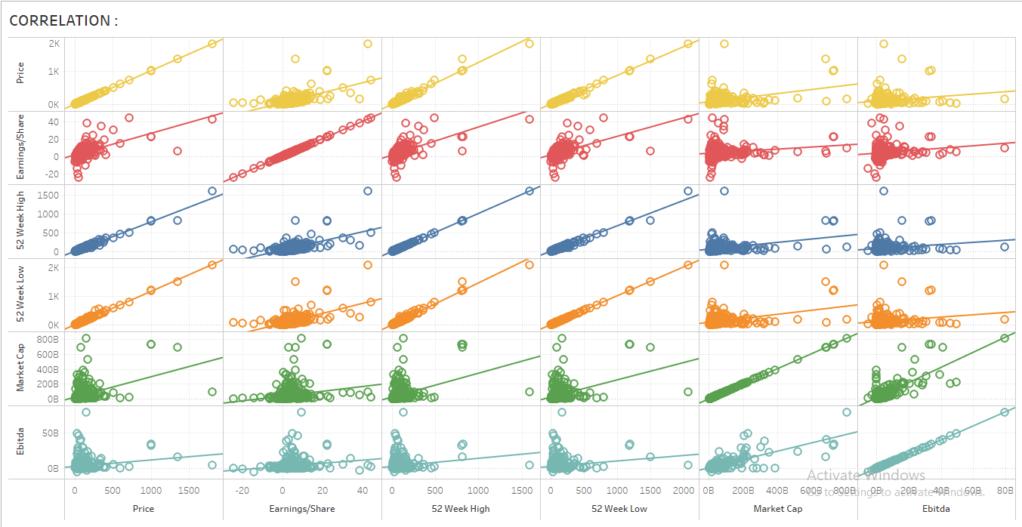
Visualization :

Slide 10
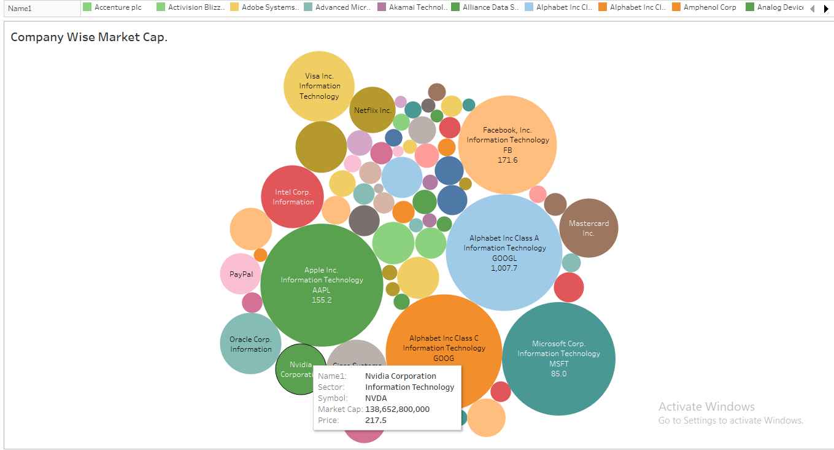

Slide 11
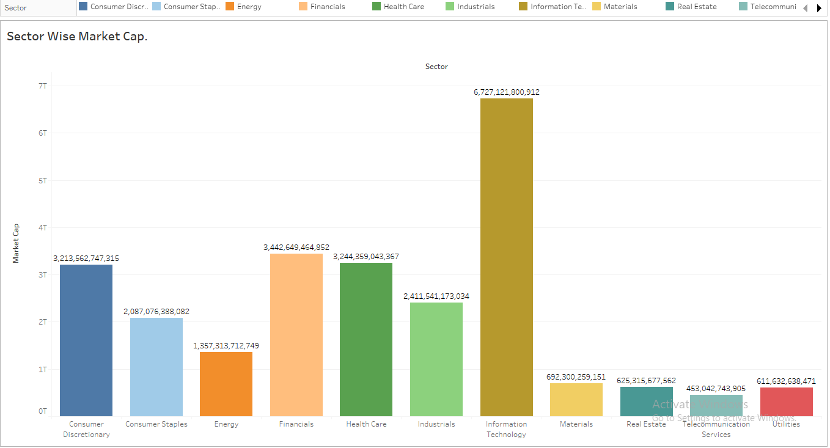

Slide 12
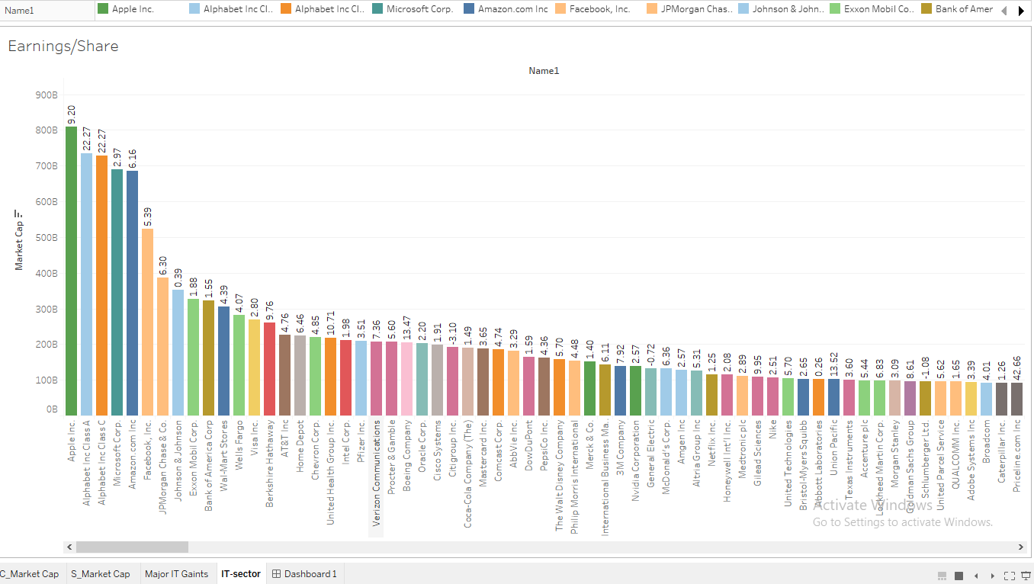

Slide 13
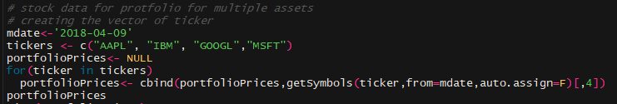
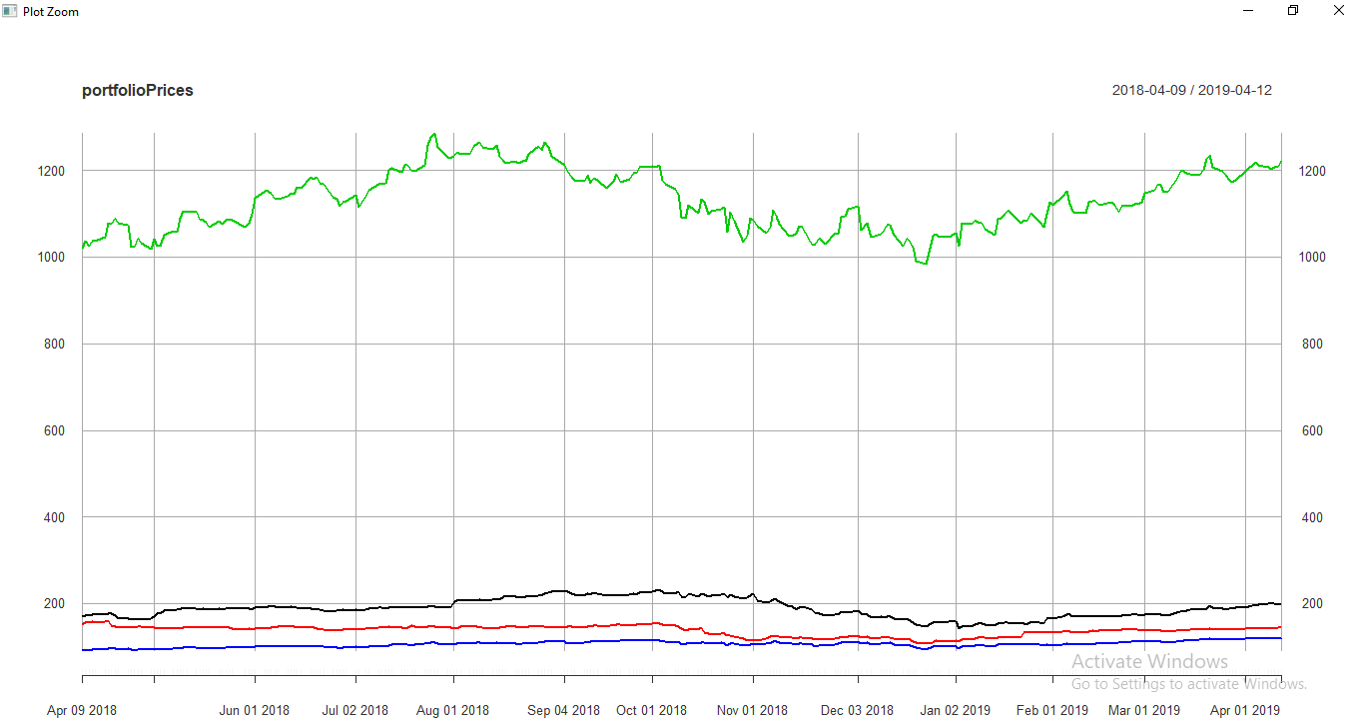
Time Series Analysis for multiple assets (close)

Slide 14
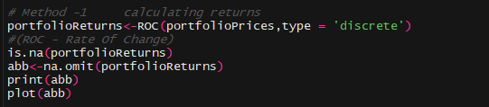
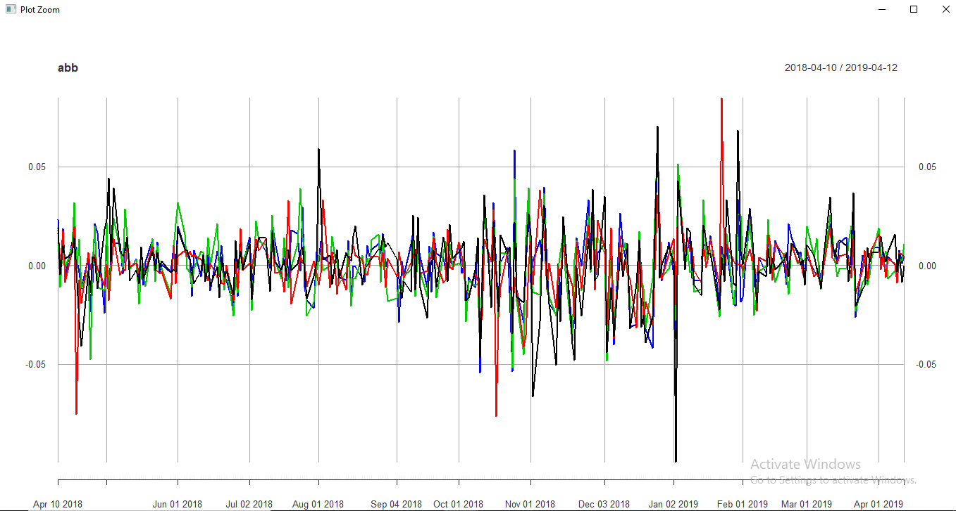
Time series Analysis of Returns

Slide 15
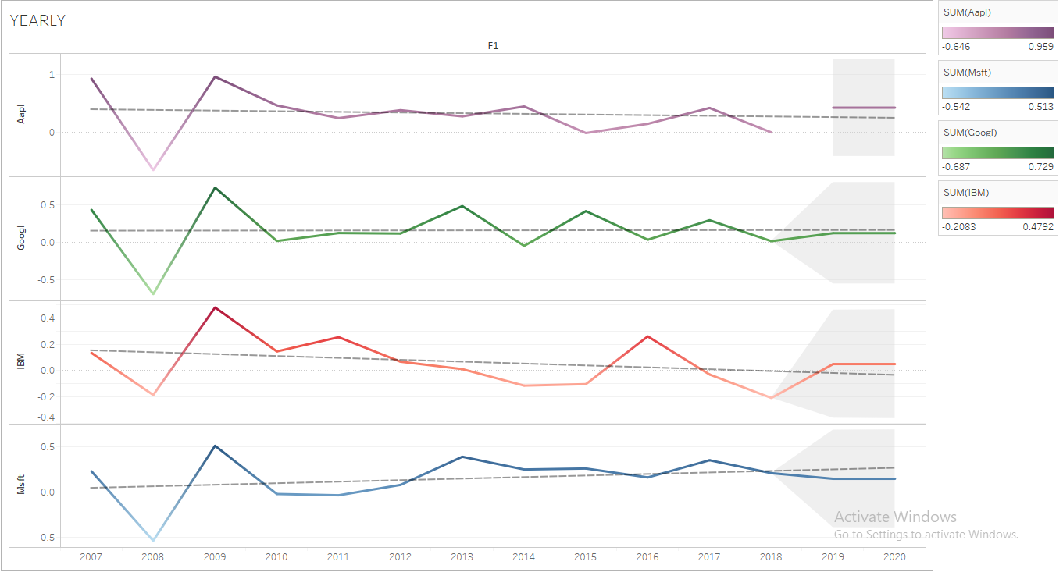
Yearly Returns (with forecasting)

Slide 16
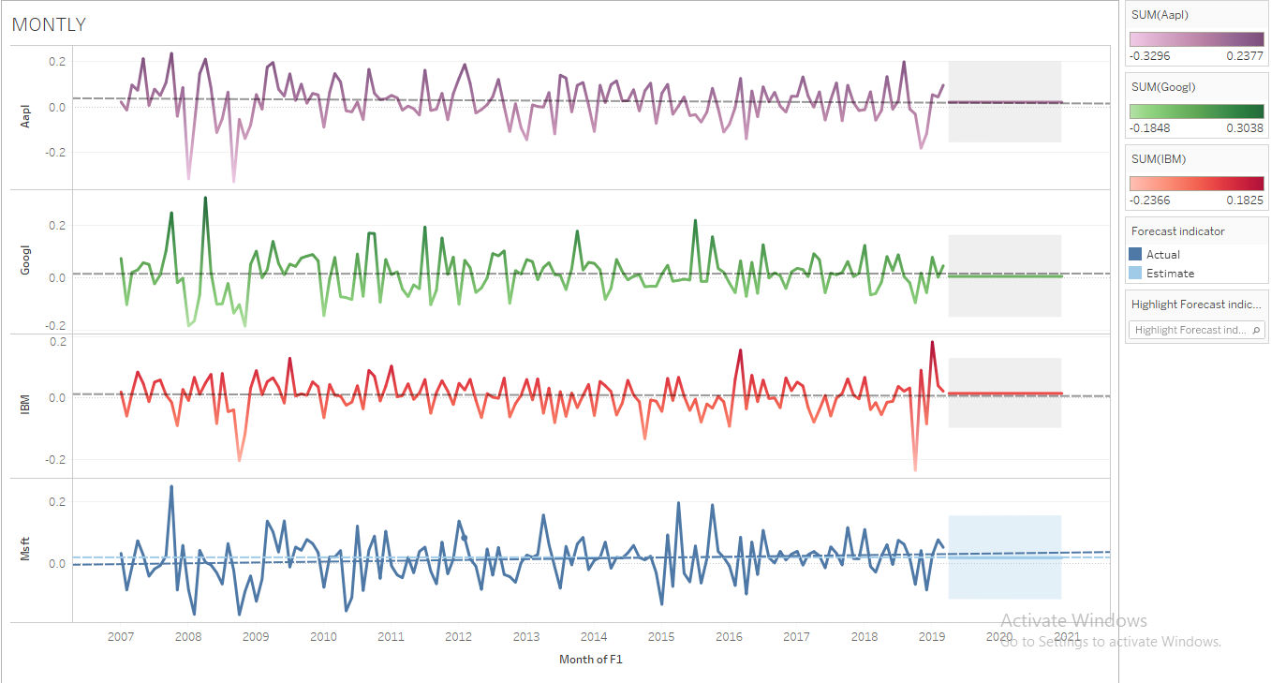
Monthly Returns (with forecasting)

Slide 17
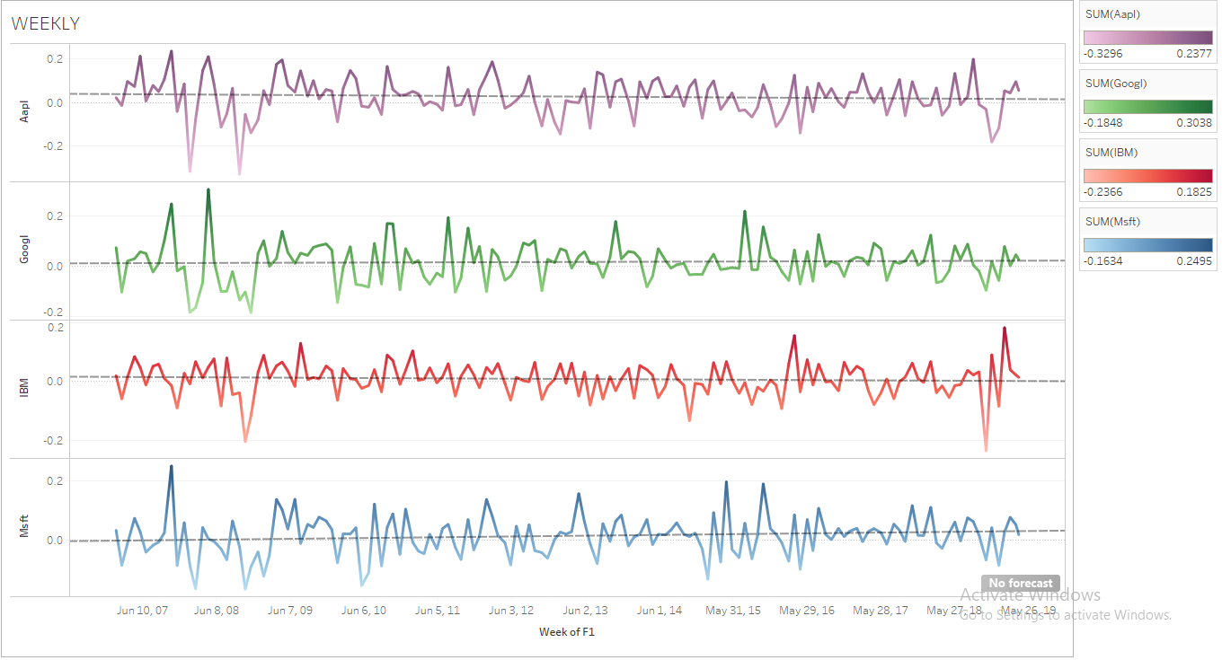
Weekly Returns (with no Forecasting)

Slide 18
Inferences :
1). By looking at the summary of the dataset we found that there are some negative values in the minimum of Price/Earnings ratio, Earnings/Share ratio and EBITDA which means there are some companies which are not performing well.
2). From the correlation visualization we gains the insights of some the variables which are highly correlated for e.g. Earnings/Share shows high correlation with price and 52 weeks high and low, similarly 52 weeks high and low shows the high correlation with respect to price. Market capitalization is highly correlated with EBITDA.
3). On visualization sector wise market capitalization we clearly found that information technology is out performing every other sector followed by Finances and Health care.

Slide 19
4). From visualizing the close of the multiple assets we found that apple company's market close is higher as compared to the other companies.
5). From visualizing the returns of the multiple assets we found that on investing in the month of october, we can expect the good amount of returns in next quarter.
6). On visualizing the forecasting on multiple assets yearly returns we found that goggle and microsoft stocks is not going to perform well in the days to come.

Slide 20
Thank you

